Slide 1
Experimental Details
Used samples: 002; 087; 161; 1001; and 1003.
Plasma volume: 20 µl.
Type of Cancer: unknown.
Concentration: unknown.
Size Distribution: unknown.
Experimental duration: 60 min.
Antibody used: CD9, CD81, and CD63.

Slide 2
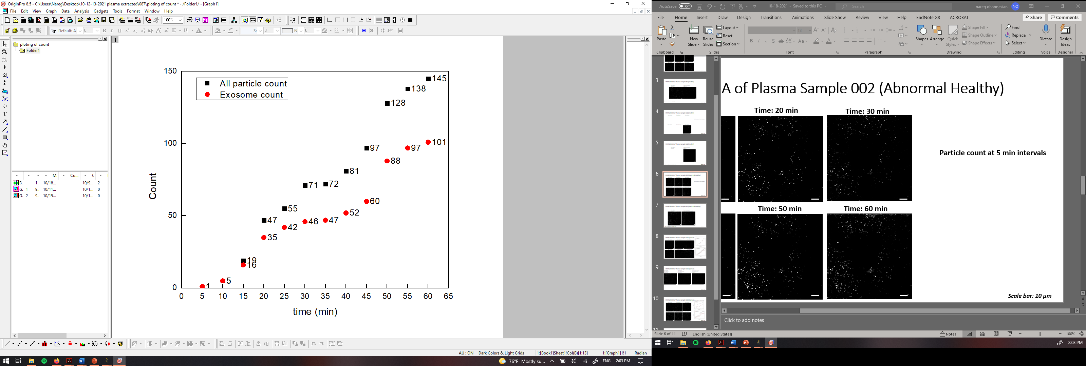
PANRORAMA of Plasma Sample 087 (Healthy)
Time: 10 min
Time: 20 min
Time: 30 min
Particle count at 5 min intervals
Time: 40 min
Time: 50 min
Time: 60 min
Scale bar: 10 µm

Slide 3
PANRORAMA of Plasma Sample 087 (Healthy)
Time: 60 min
Count: 145
Time: 60 min wash
Count: 37
Note: No response to miRNA-21 mb
Scale bar: 10 µm

Slide 4
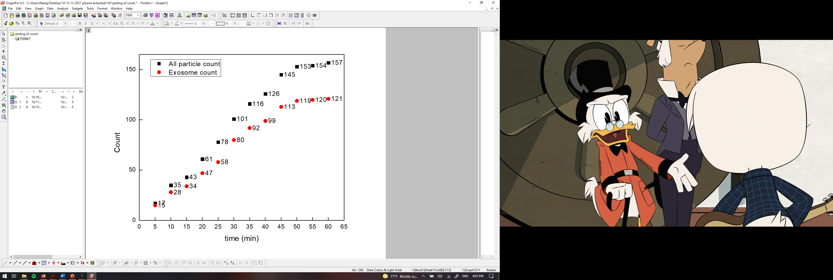
PANRORAMA of Plasma Sample 161 (Healthy)
Time: 10 min
Time: 20 min
Time: 30 min
Particle count at 5 min intervals
Time: 40 min
Time: 50 min
Time: 60 min
Scale bar: 10 µm

Slide 5

PANRORAMA of Plasma Sample 161 (Healthy)
Time: 60 min
Count: 157
Time: 60 min wash
Count: 25
Note: No response to miRNA-21 mb
Scale bar: 10 µm

Slide 6
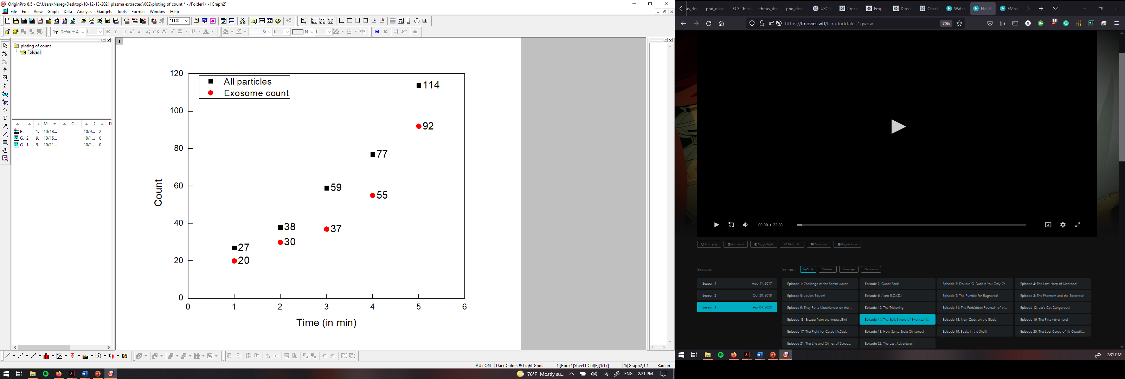
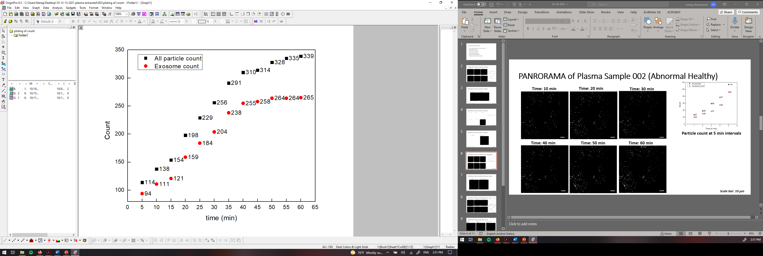
PANRORAMA of Plasma Sample 002 (Abnormal Healthy)
Time: 10 min
Time: 20 min
Time: 30 min
Particle count at 5 min intervals
Time: 40 min
Time: 50 min
Time: 60 min
Scale bar: 10 µm

Slide 7
PANRORAMA of Plasma Sample 002 (Abnormal Healthy)
Time: 60 min
Count: 310
Time: 60 min wash
Count: 176
Note: No response to miRNA-21 mb
Scale bar: 10 µm

Slide 8
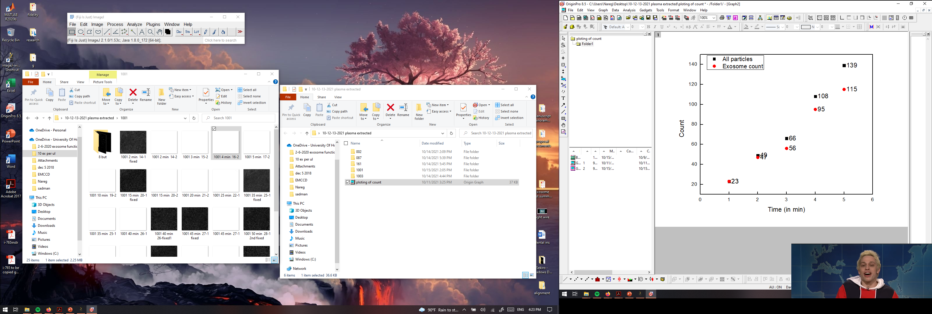
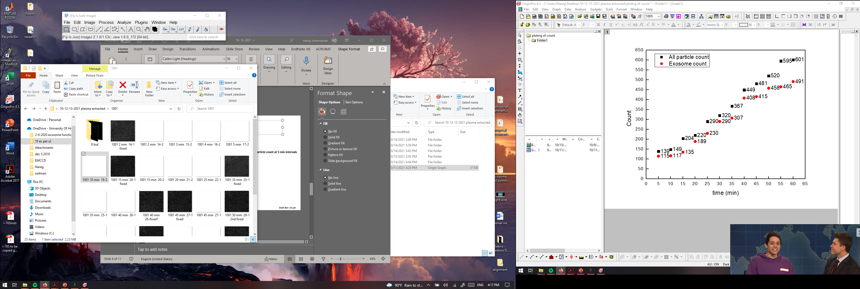


PANRORAMA of Plasma Sample 1001 (Cancer)
Particle count at 1 min intervals
Time: 10 min
Time: 20 min
Time: 30 min
Particle count at 5 min intervals
Time: 40 min
Time: 50 min
Time: 60 min
Scale bar: 15 µm

Slide 9

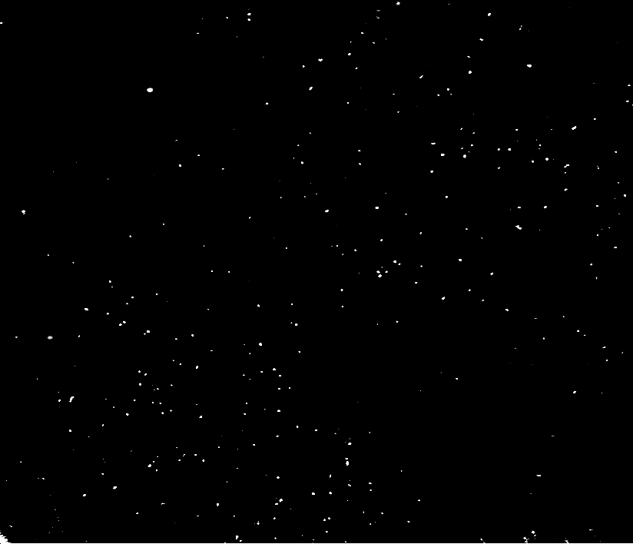

PANRORAMA of Plasma Sample 1001 (Cancer)
PANORAMA
Time: 60 min
Count: 670
PANORAMA
Time: 60 min wash
Count: 394
Fluorescence (13.5 %)
Time: 60 min wash
Count: 53
Scale bar: 15 µm

Slide 10
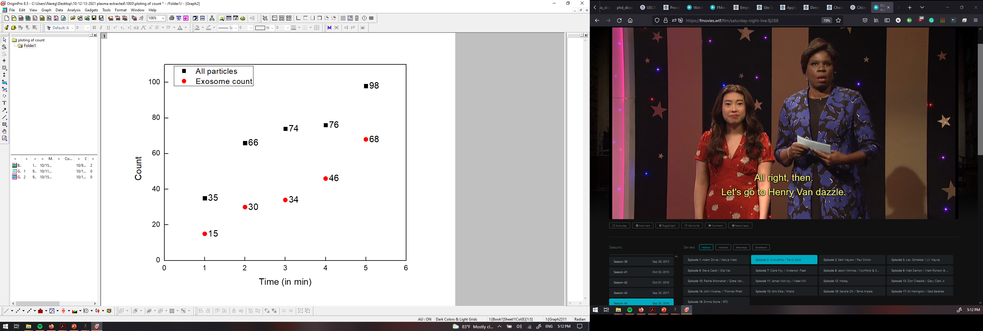
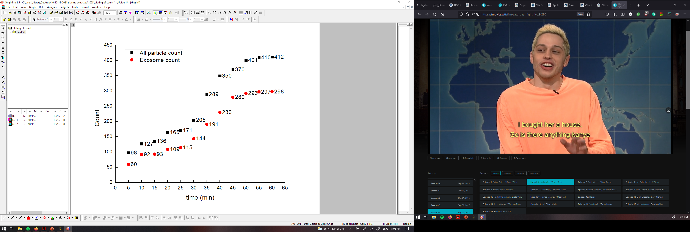
PANRORAMA of Plasma Sample 1003 (Cancer)
Particle count at 1 min intervals
Time: 10 min
Time: 20 min
Time: 30 min
Particle count at 5 min intervals
Time: 40 min
Time: 50 min
Time: 60 min
Scale bar: 10 µm

Slide 11


PANRORAMA of Plasma Sample 1003 (Cancer)
PANORAMA
Time: 60 min
Count: 412
PANORAMA
Time: 60 min wash
Count: 289
Fluorescence (10.3 %)
Time: 60 min wash
Count: 29
Scale bar: 10 µm

Slide 12
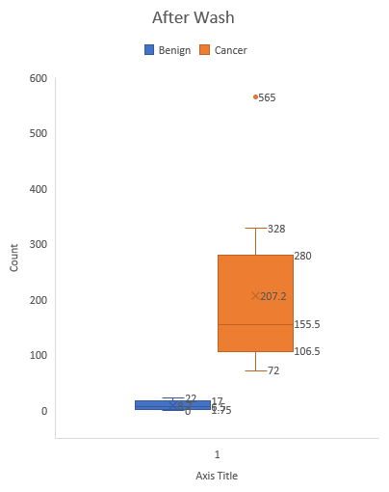
Count of attached exosomes for plasma samples
Sample | Count AW | Type
087 | 37 | Healthy
161 | 25 | Healthy
1001 | 394 | Cancer
1003 | 289 | Cancer

Slide 13
Experimental Details
Used samples: 1;2;3;4;5;6;7;8;9;10;X and Y.
Plasma volume: 20 µl.
Type of Cancer: unknown.
Concentration: unknown.
Size Distribution: unknown.
Experimental duration: 60 min.
Antibody used: CD9, CD81, and CD63.

Slide 14
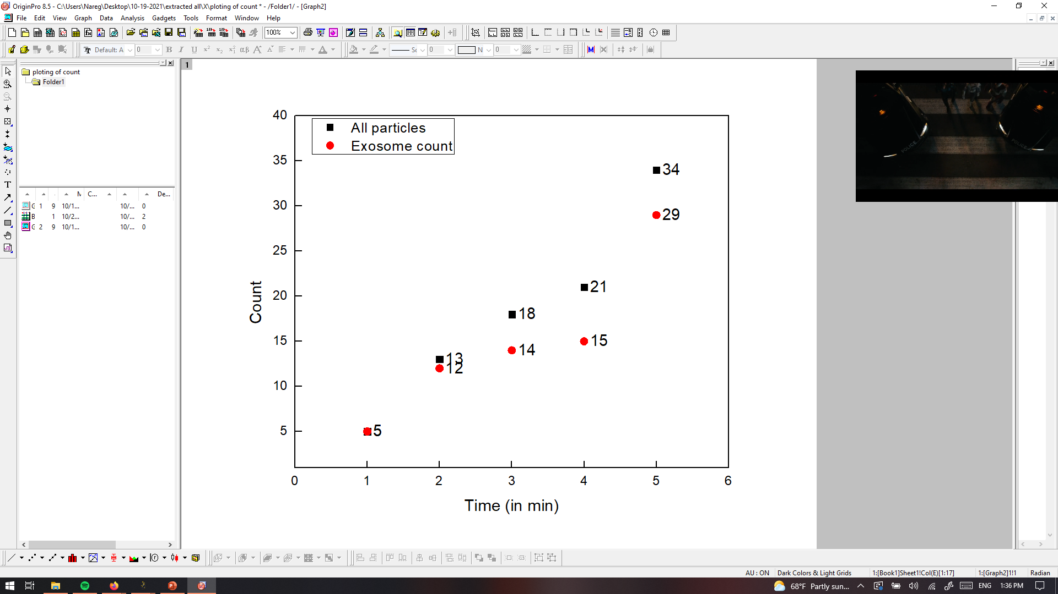
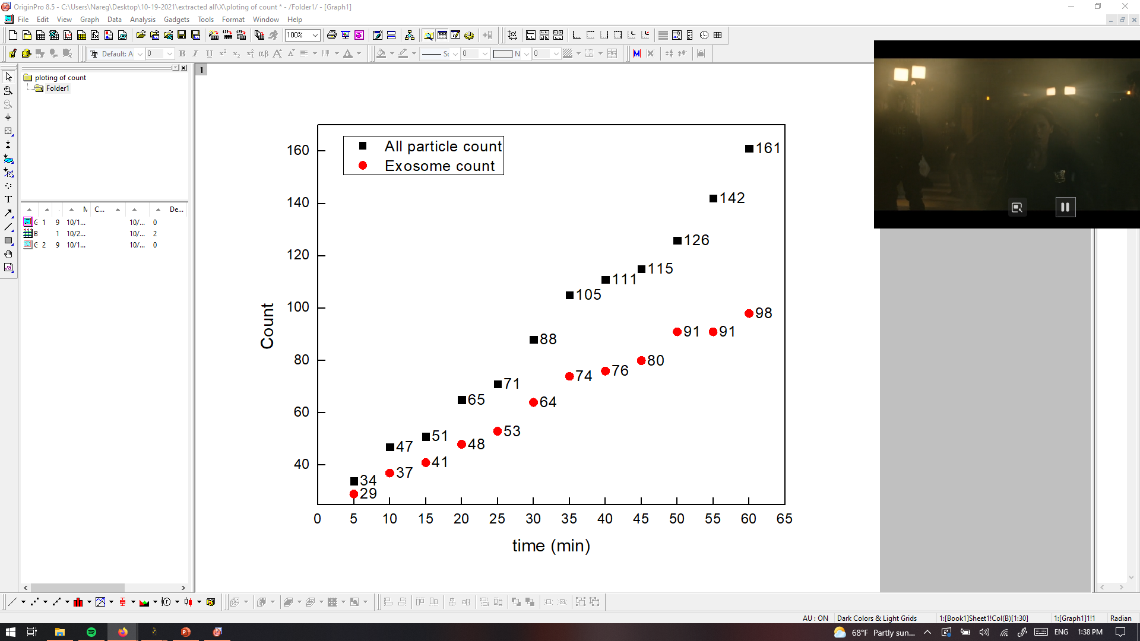
PANRORAMA of Plasma Sample X=002? (prediction Healthy)
Time: 10 min
Time: 20 min
Time: 30 min
Particle count at 5 min intervals
Time: 40 min
Time: 50 min
Time: 60 min
Scale bar: 10 µm

Slide 15
PANRORAMA of Plasma Sample X=002? ( prediction Healthy)
Time: 60 min
Count: 171
Time: 60 min wash
Count: 74
2nd time
Before wash: 185
After wash: 67
Note: No response to miRNA-21 mb
Scale bar: 10 µm

